Slide 1
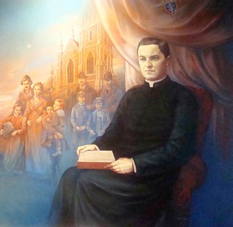
Knights of Columbus Evangelization and Faith Formation (EFF) The Cor (from the heart) Meeting
Sean Burlile, State Director EFF
Pat King, State Director EFF

Slide 2
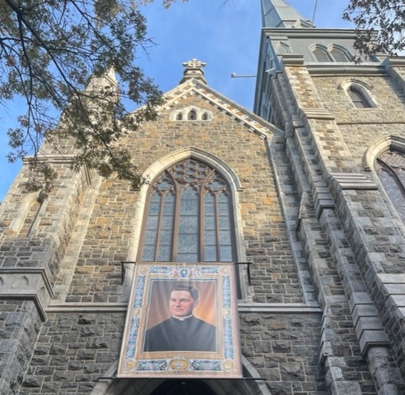
Knights of Columbus • Father Michael McGivney (1882) • St. Mary’s Catholic Church • Freemasonry / Anti-Catholic Bigotry
Founding Principles: prayer, formation, fraternity, service, and support for widows and children (life insurance)

Slide 3
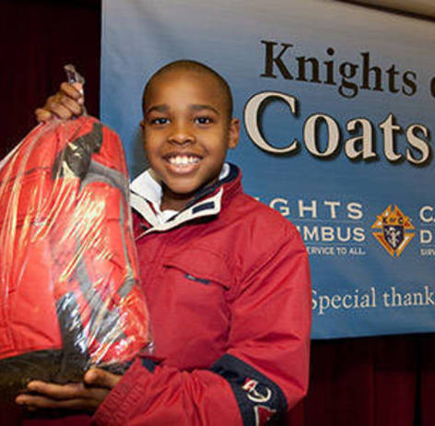
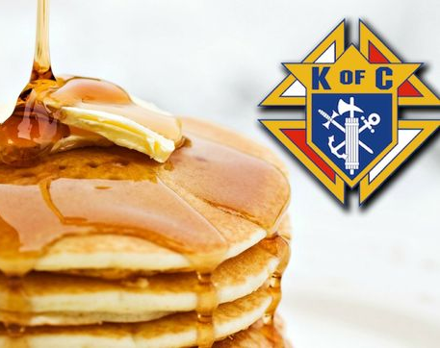
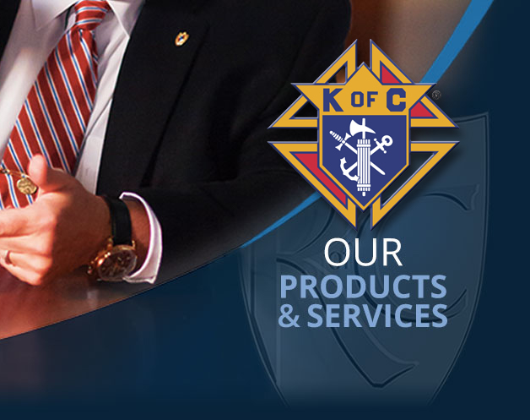
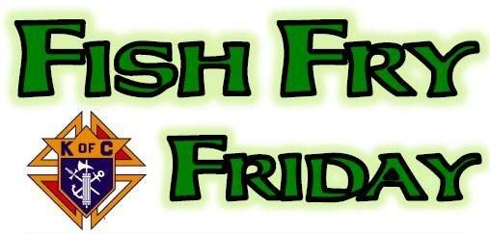
Knights in Action…
• Pancake Breakfasts
• Fish Fry
• Coats for Kids
• Global Wheelchair Mission
• Life Insurance
We Do A lot!

Slide 4
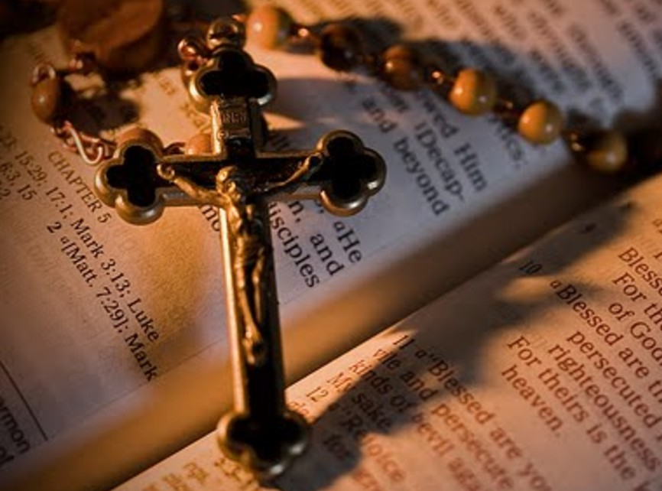
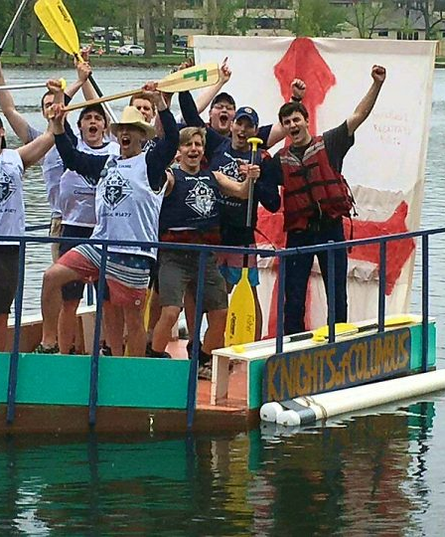
• Prayer – Brings us closer to Christ • Formation – Develops us as disciples of Christ • Fraternity – Builds up the body of Christ
Enhancing Prayer, Formation, and Fraternity

Slide 5
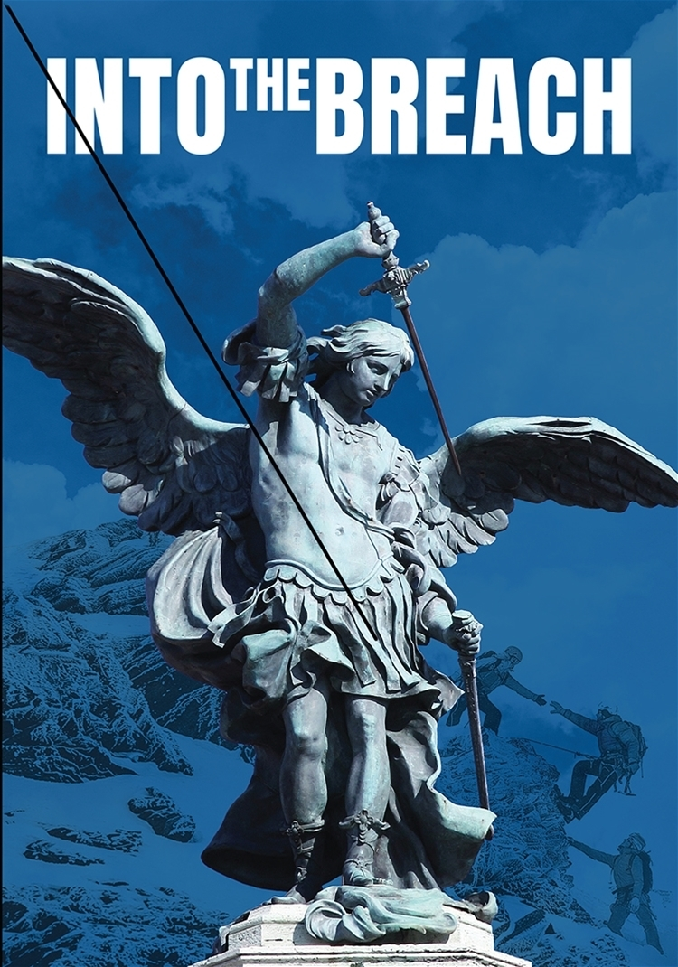
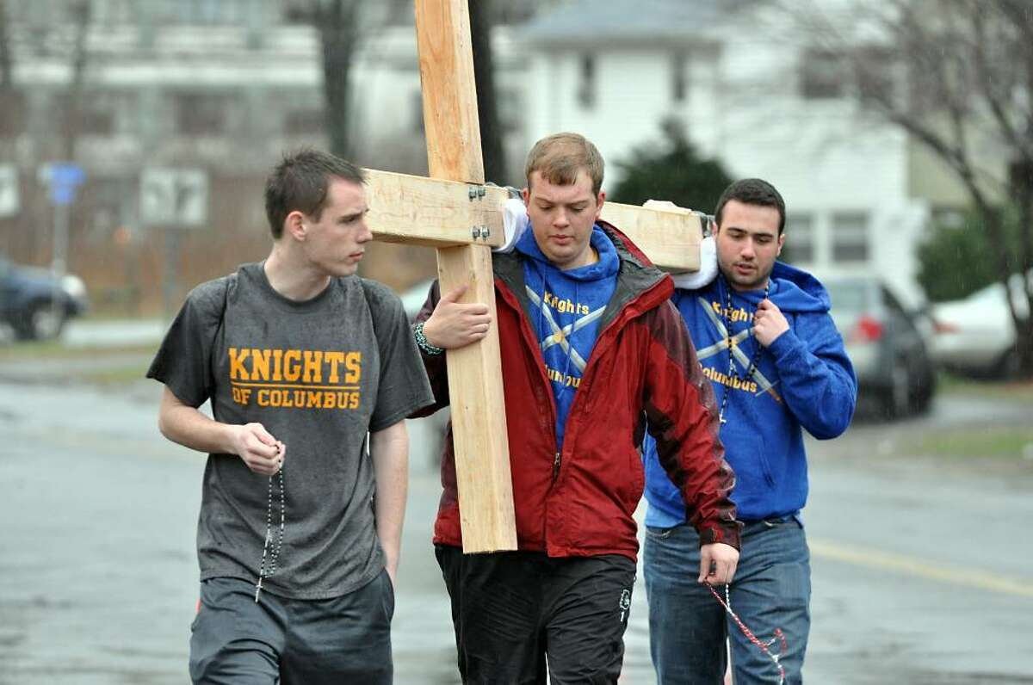
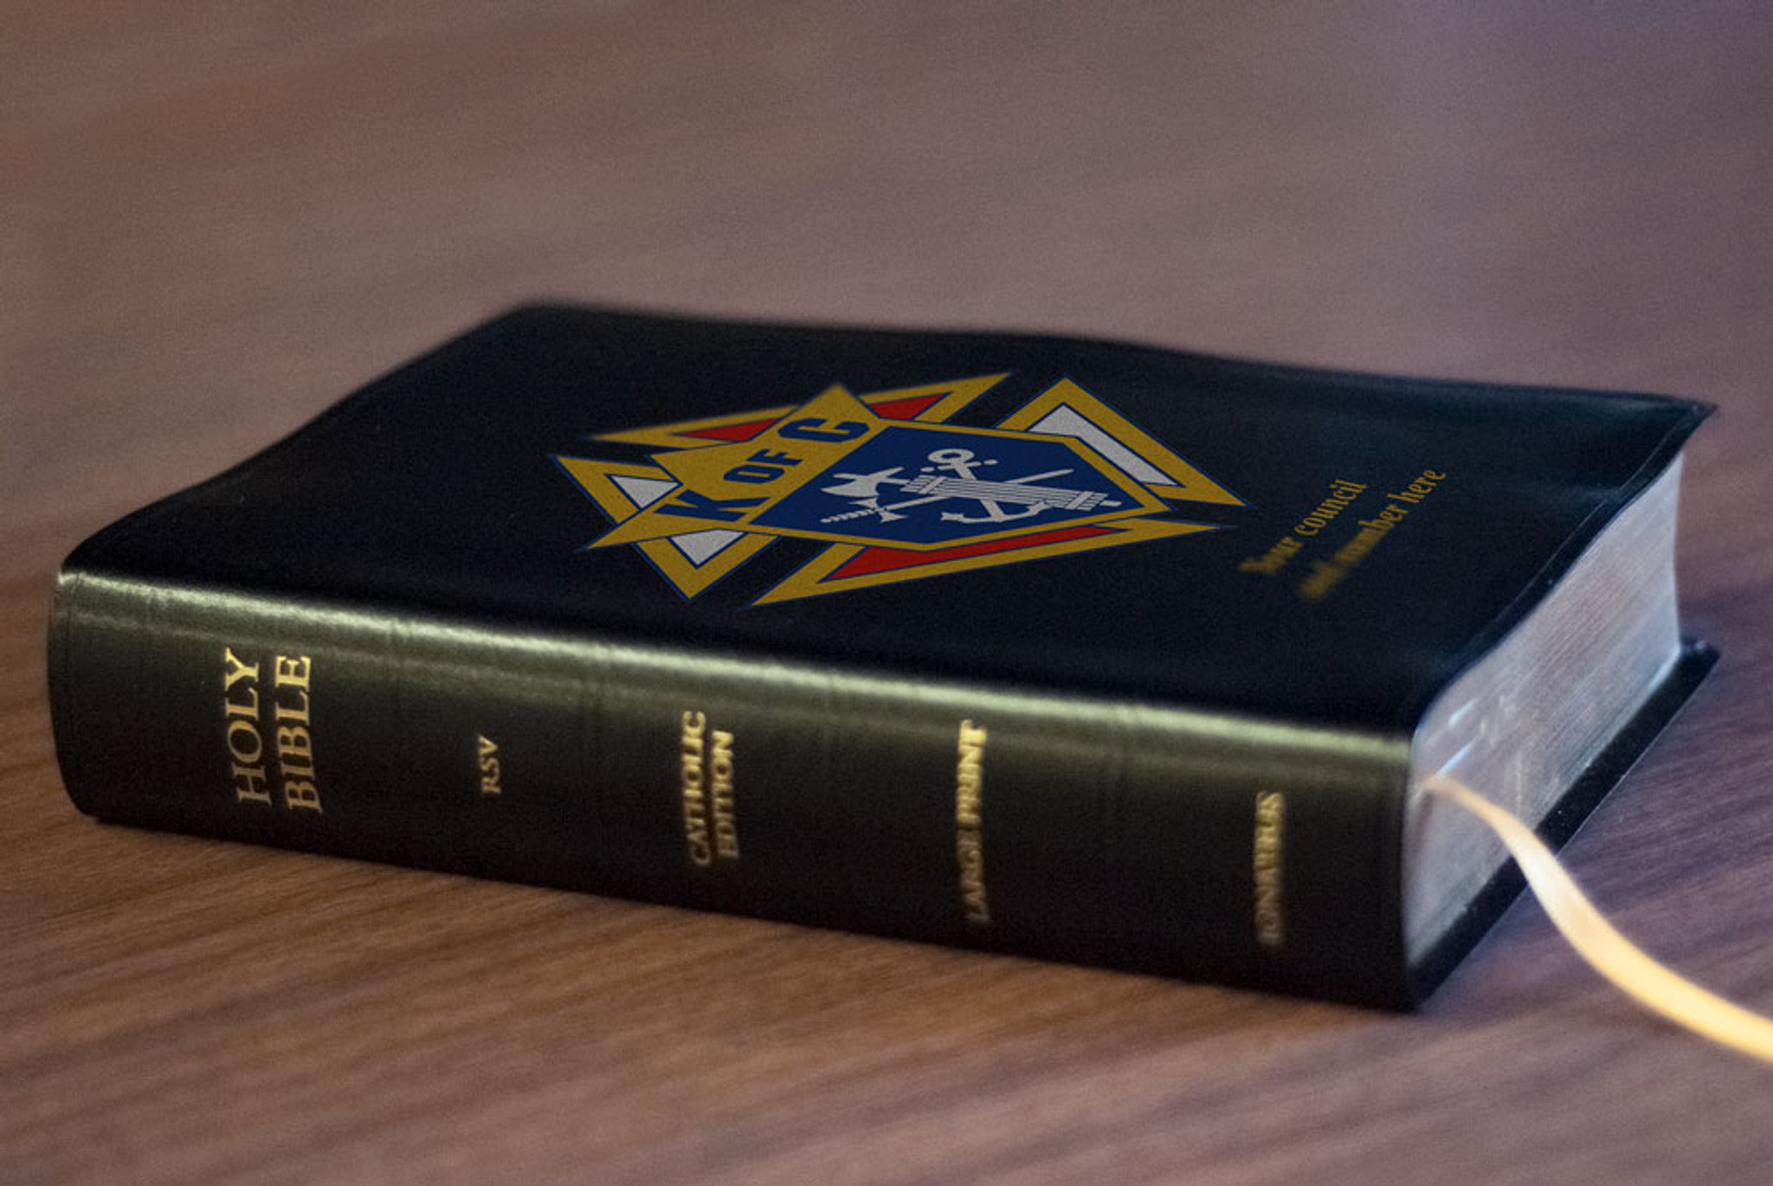
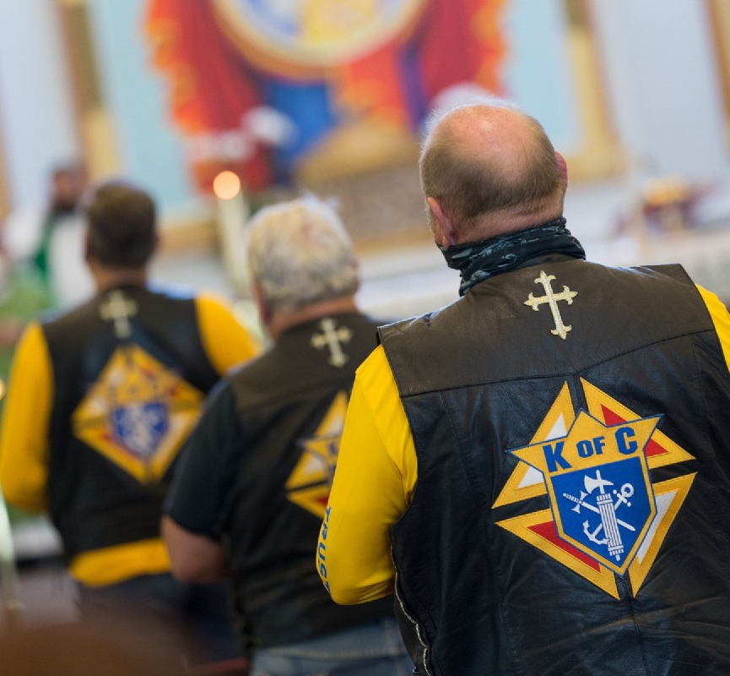
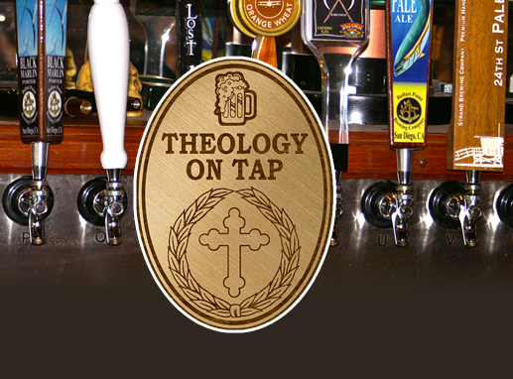
The Cor (from the heart) Meeting
Key Elements: Prayer, Formation,
Fraternity
Meeting Ideas: Prayer group, Bible
Study, Into the Breach, Theology on
Tap, Knights on Bikes, etc.
Small Groups
Food and Drink

Slide 6
Cor Resources
• Bible
• Catechism
• Rosary
• Into the Breach
• Guest Speakers
• Priests
• Deacons
• Local Pilgrimage
• State Directors of Evangelization and Faith Formation
• Let the creative juices flow…

Slide 7
Benefits of Joining The Cor
• Brings people closer to Christ
• Forms missionary disciples
• Enhances fraternal relationships
• Enhances the service aspect of the order
• Helps with recruitment and retention

Slide 8
Next Steps – How to Get Started
Step 1: Attend information session presented by State Director of
Evangelization and Faith Formation
Step 2: Council Director of Evangelization and Faith Formation appointed
by Grand Knight (with support of pastor)
Step 3: Start Cor meetings
Step 4: Utilize State Director of Evangelization and Faith Formation for
ongoing support

Slide 9
Questions

