Slide 1
2020-2021 District 5 Organizational Meeting
Welcome!
Bienvenido!

Slide 2
Introductions & Pledge of Allegiance
The Power of Change
Fraternity – Leave No Neighbor Behind
Safe Environment
Training Your Replacement
Communication
Ceremonials
Socials
Family
The Power of Change
Where do we go from here?
Closing Prayer
Cory Newell
District Deputy 5
dd5@idahokofc.org
208-921-6984

Slide 4
The Power of Change What has changed and Why? Requirements Faith in Action

Slide 5
What’s New
Changes:
Combined Degree of Charity, Unity and Fraternity
Ceremonials
Secrecy
Fr. McGivney Award
Founders’ Award
Columbian Award
Supreme Council Per Capita
Requirements:
Form 185 7/1
Form 365 – Safe Environment 8/1
Council Audit 8/15
Form 1728 – Survey of Fraternal Activity 1/31
Faith In Action – Columbian Award 6/30

Slide 6
FAITH IN ACTION KofC.org/faithinaction

Slide 7
FAITH RSVP Into the Breach Spiritual Reflection Program Holy Hour Marian Icon Prayer Program Building Church Kiosk Rosary Program Sacramental Gifts | COMMUNITY Coats for Kids Global Wheelchair Mission Habitat for Humanity Leave No Neighbor Behind Disaster Preparedness Free Throw Championship Soccer / Hockey Challenge Catholic Citizenship Essay Contest Helping Hands
FAMILY Food for Families Family of the Month/Year Family Prayer Night Family Fully Alive Keep Christ in Christmas Family Week Consecration to the Holy Family Good Friday Family Promotion | LIFE March for Life Special Olympics Ultrasound Program Pregnancy Center Support Christian Refugee Relief Silver Rose Mass for People with Special Needs Novena for Life

Slide 8
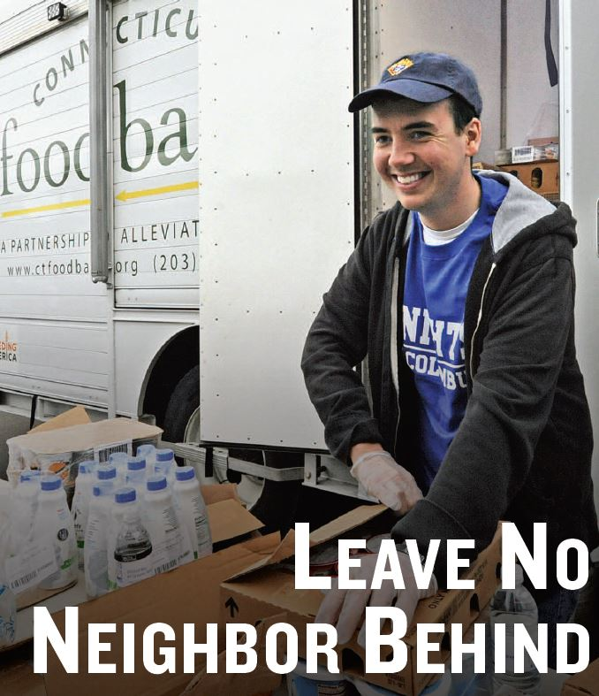
Fraternity
Support your Brother Knights and their families
Feed the Hungry
Support your Pastor and Parish
Participate in Blood Drives
Support your Community

Slide 9
Safe Environment http://www.kofc.org/safe

Slide 10
Office of Youth Protection
Safe Environment Program
Our Safe Environment Program safeguards children and other vulnerable persons, assures members and their families that we maintain a safe environment, protects members from awkward situations, misunderstandings, and appearances of impropriety, builds trust with arch/dioceses and parishes, and protects the good name of the Knights of Columbus.
For Members in These Roles
Triggered from the Service Program Personal Report (Form #365)
Grand Knight - Training
Program Director - Training
Community Director – Training & Background Check
Family Director – Training & Background Check
https://armatus2.praesidiuminc.com/armatusUser/login
For All Other Members
Members not listed on the other button, are encouraged to take the training as well by pressing the blue button.
The Registration Code is kofcsafe.
http://praesidiuminc.com/enroll
Anyone suspecting abuse should (1) report suspected abuse to law enforcement; (2) notify the local diocese of the suspected abuse; and (3) notify the Knights of Columbus of the suspected abuse at 1-844-KOFC-SAFE (1-844-563-2723)
From http://www.kofc.org/un/en/members/programs/youth-activities/safe-environment-program.html
Safe Environment
Notes:
What’s the first problem identified when planning a Church Drive? When a council starts planning the drive TOO LATE. You should begin planning and preparing for your church drive six to eight weeks in advance. Otherwise, you run the risk of running into issues with scheduling and receiving supplies. Early preparation can be the difference between a successful church drive and a sub-par one.
Now is the time to order your supplies for the Church Drive. Twice a year, shipping for the Church Recruitment Drive Kit is available for all councils free of cost by using the “Church Recruitment Drive Materials Order Form.” For participants of this webinar, you will be exclusively eligible to receive TWO (2) Church Recruitment Drive Kits free of shipping by using the Order Form located in the “Resources” tab. Remember, this special offer is only for listeners of this webinar and can only be accessed by using the special form in the “Resources” tab. This offer will be available from now through December 31, 2017, so be sure to order yours TODAY! We also suggest ordering KofC promotional items for your recruitment team to give away to those with whom you speak during the Church Drive as a “thank you” for their time and consideration. It will be a great way to remind the recruit about the Knights, and who doesn’t love SWAG? Depending on your situation, you might even consider getting items to give to wives and children of the men with whom you speak. KnightsGear.com has a wide range of items to choose from, in addition to our other authorized suppliers. See the KofC Supply Catalog, available in the “Resources” tab, for more information.
Now, you’re ready to seek permission from the pastor and any other parish officials necessary. This ought to be done via a soft approach. Don’t make the mistake of assuming your pastor will automatically grant permission without any explanation. Take the time to explain to him what you’re planning to do and how it will benefit him & the parish. Be respectful of his time and authority. Don’t be hard-set on a date. If he says you can’t do it on the 7th, and you have to do it on the 14th, then you’re doing it on the 14th! One you have permission, make sure it goes on everyone’s calendar: Father’s Calendar, Church Calendar, Council Calendar, Officers Calendar, Membership Director’s Calendar, etc.
You will want to take time to prepare publicity notices such as posters, flyers, and the wording for your church bulletin/website. Many of these materials are already included in the Church Recruitment Drive kit. On pages 25-27 of the Membership Recruitment and Retention Manual, there are sample announcements for the bulletin, pulpit, and even suggested wording for the celebrant at Mass. Four sample pulpit announcements are available in the “Resources” tab, as well. You can use these & tailor them to your parish.

Slide 11
IDAHO COUNCILS NOT SUBMITTING REPORT OF OFFICERS CHOSEN
As of: 07/30/2020
1554 2014 2685 3013 3841 4013 4777 5075 5335 5444
8283 8780 12854 12881 12895 12953 13089 15047 16757
IDAHO COUNCILS NOT SUBMITTING SERVICE PROGRAM PERSONNEL REPORT
07/30/2020
1389 1416 1554 1663 2014 2888 3085 3086 3703 3762 3841 4013 4058 4777 8780 10581 12172 12531 12560 12854 12881 12895 12953 13089 15047 16757 17059
Idaho District 5 - Safe Environment Member Status
 |  |  |  |  |  | Report As Of Date: |  |  | 07/23/2020
Unit Number | Member Number | Role | Name | Training Program Type | Training Program Start Date |  | Training Due By/Compliance | Re-training Eligibility Date |  | Background Check Start Date | Background Check Due By/Compliance |  | Re-screening Eligibility Date | Member Status
11548 | 4457560 | Family Director (519) | DENNIS R SHAUL | Initial | 2020-07-24 |  | Compliant | 2021-12-11 |  | 2018-08-06 | Compliant |  | 2021-09-10 | Compliant
11548 | 4712082 | Grand Knight (501) | SCOTT A HOLMAN | Initial | 2020-07-17 |  | Compliant | 2022-08-11 |  | n/a | n/a |  |  | Compliant
11548 | 5062857 | Program Director (511) | DAVID J CEREGHINO | Initial | 2020-07-24 |  | 2020-09-11 |  |  | n/a | n/a |  |  | Pending
17059 | 4412030 | Grand Knight (501) | TRAVIS D WINGO | Initial | 2020-07-17 |  | Compliant | 2021-10-31 |  | n/a | n/a |  |  | Compliant
Notes:
What’s the first problem identified when planning a Church Drive? When a council starts planning the drive TOO LATE. You should begin planning and preparing for your church drive six to eight weeks in advance. Otherwise, you run the risk of running into issues with scheduling and receiving supplies. Early preparation can be the difference between a successful church drive and a sub-par one.
Now is the time to order your supplies for the Church Drive. Twice a year, shipping for the Church Recruitment Drive Kit is available for all councils free of cost by using the “Church Recruitment Drive Materials Order Form.” For participants of this webinar, you will be exclusively eligible to receive TWO (2) Church Recruitment Drive Kits free of shipping by using the Order Form located in the “Resources” tab. Remember, this special offer is only for listeners of this webinar and can only be accessed by using the special form in the “Resources” tab. This offer will be available from now through December 31, 2017, so be sure to order yours TODAY! We also suggest ordering KofC promotional items for your recruitment team to give away to those with whom you speak during the Church Drive as a “thank you” for their time and consideration. It will be a great way to remind the recruit about the Knights, and who doesn’t love SWAG? Depending on your situation, you might even consider getting items to give to wives and children of the men with whom you speak. KnightsGear.com has a wide range of items to choose from, in addition to our other authorized suppliers. See the KofC Supply Catalog, available in the “Resources” tab, for more information.
Now, you’re ready to seek permission from the pastor and any other parish officials necessary. This ought to be done via a soft approach. Don’t make the mistake of assuming your pastor will automatically grant permission without any explanation. Take the time to explain to him what you’re planning to do and how it will benefit him & the parish. Be respectful of his time and authority. Don’t be hard-set on a date. If he says you can’t do it on the 7th, and you have to do it on the 14th, then you’re doing it on the 14th! One you have permission, make sure it goes on everyone’s calendar: Father’s Calendar, Church Calendar, Council Calendar, Officers Calendar, Membership Director’s Calendar, etc.
You will want to take time to prepare publicity notices such as posters, flyers, and the wording for your church bulletin/website. Many of these materials are already included in the Church Recruitment Drive kit. On pages 25-27 of the Membership Recruitment and Retention Manual, there are sample announcements for the bulletin, pulpit, and even suggested wording for the celebrant at Mass. Four sample pulpit announcements are available in the “Resources” tab, as well. You can use these & tailor them to your parish.

Slide 12
Training Your Replacement

Slide 13
Future Leaders
Who am I?
Relationships
Identify
Introduce yourself
LISTEN
Be present
Follow-up
Introduce someone
Mindshare
Identify current skills and abilities
Train and educate to fill in the gaps
Duties | Roles | Responsibilities
Partner | Mentor | Enable
www.kofc.org/training

Slide 14
Mission Vision

Slide 15
Mission
Blessed Fr. McGivney’s mission of the Knights of Columbus:
… is an Order composed of Catholics and instituted for the welfare of Catholic families … Not only in sickness, but when death takes the support of the family away, the Knights of Columbus come to the relief of the widow and the orphan in a very substantial manner
The mission of Idaho State District 5 is to educate and train local Knights to lead their councils and to motivate men to live their faith through acts of charity, fraternity and unity; to encourage local Knights to build stronger Catholic families and to become better fathers, husbands and Catholic gentleman. We promote the building of solid relationships within our councils, parish and communities by creating open lines of communication while increasing member’s faith and improving charitable programs.
The mission of Council 17059 Blessed Frassati is to perform charitable works for the benefit and improvement of community and family. Work for the betterment of our shared Catholic faith. Strive to make a difference in people’s lives as the champions of good Catholic values.

Slide 17
Vision
Blessed Fr. McGivney’s vision of the Knights of Columbus:
Change a man’s life
Deepen and enrich his faith
Strengthen his family
Build better lives for those who so desperately need help
The vision of Idaho State District 5:
In Progress
The vision of Council 17059 Blessed Frassati is to be the vision we want to see. Exemplify our faith and Catholic lay leadership, build the Domestic Church and put our faith in to action. Share our faith through example and presence to our parish and community. Celebrate fraternity with loved ones socially and in good works. Stand shoulder to shoulder to aid the community and defend life at all stages and in all conditions. Make families and members the center of our council by uniting their knowledge and skills.

Slide 18
Goals

Slide 20
Building & Maintaining Relationships as a KofC Leader
Ken Rief
District Warden
Ken.rief@gmail.com
925-200-5406

Slide 21
The Importance of Ceremonies
Understand the Basics of Building Relationships
Secrets to Creating and Managing a Relationship
Steps to get Started
Council Technology Director

Slide 22
Communication:
Building a Strong Member Communication Process:
Communicate Consistently
Surveys - email a survey and publish results
Determine what works best for your council
Phone call, Email, Text, Newsletter, Calendar, Apps, Blog, Bulletins
Focus on consistency over quantity
Ensure published (website) information is accurate
Notes:
What’s the first problem identified when planning a Church Drive? When a council starts planning the drive TOO LATE. You should begin planning and preparing for your church drive six to eight weeks in advance. Otherwise, you run the risk of running into issues with scheduling and receiving supplies. Early preparation can be the difference between a successful church drive and a sub-par one.
Now is the time to order your supplies for the Church Drive. Twice a year, shipping for the Church Recruitment Drive Kit is available for all councils free of cost by using the “Church Recruitment Drive Materials Order Form.” For participants of this webinar, you will be exclusively eligible to receive TWO (2) Church Recruitment Drive Kits free of shipping by using the Order Form located in the “Resources” tab. Remember, this special offer is only for listeners of this webinar and can only be accessed by using the special form in the “Resources” tab. This offer will be available from now through December 31, 2017, so be sure to order yours TODAY! We also suggest ordering KofC promotional items for your recruitment team to give away to those with whom you speak during the Church Drive as a “thank you” for their time and consideration. It will be a great way to remind the recruit about the Knights, and who doesn’t love SWAG? Depending on your situation, you might even consider getting items to give to wives and children of the men with whom you speak. KnightsGear.com has a wide range of items to choose from, in addition to our other authorized suppliers. See the KofC Supply Catalog, available in the “Resources” tab, for more information.
Now, you’re ready to seek permission from the pastor and any other parish officials necessary. This ought to be done via a soft approach. Don’t make the mistake of assuming your pastor will automatically grant permission without any explanation. Take the time to explain to him what you’re planning to do and how it will benefit him & the parish. Be respectful of his time and authority. Don’t be hard-set on a date. If he says you can’t do it on the 7th, and you have to do it on the 14th, then you’re doing it on the 14th! One you have permission, make sure it goes on everyone’s calendar: Father’s Calendar, Church Calendar, Council Calendar, Officers Calendar, Membership Director’s Calendar, etc.
You will want to take time to prepare publicity notices such as posters, flyers, and the wording for your church bulletin/website. Many of these materials are already included in the Church Recruitment Drive kit. On pages 25-27 of the Membership Recruitment and Retention Manual, there are sample announcements for the bulletin, pulpit, and even suggested wording for the celebrant at Mass. Four sample pulpit announcements are available in the “Resources” tab, as well. You can use these & tailor them to your parish.

Slide 23
Navigating to the new Knights of Columbus Idaho State and District Website
State:
https://www.idahokofc.org
District:
https://www.idahokofc.org/district5
Universal Prospect Page:
https://info.kofc.org/us.html

Slide 24
Socials
Help to bridge the gap between council and families
Builds Fraternity
Work hard and play easy
Pair them with a Charitable Program to conclude the day
Invite parishioners and candidates

Slide 25
Family Men want to lead their families not leave their families

Slide 26
Fraternal Benefit Night Paul Ford & Trey Schorr

Slide 27
Where do we go from here?

Slide 28
Closing Prayer
Thank You!
Gracias!

Slide 29
